Slide 1

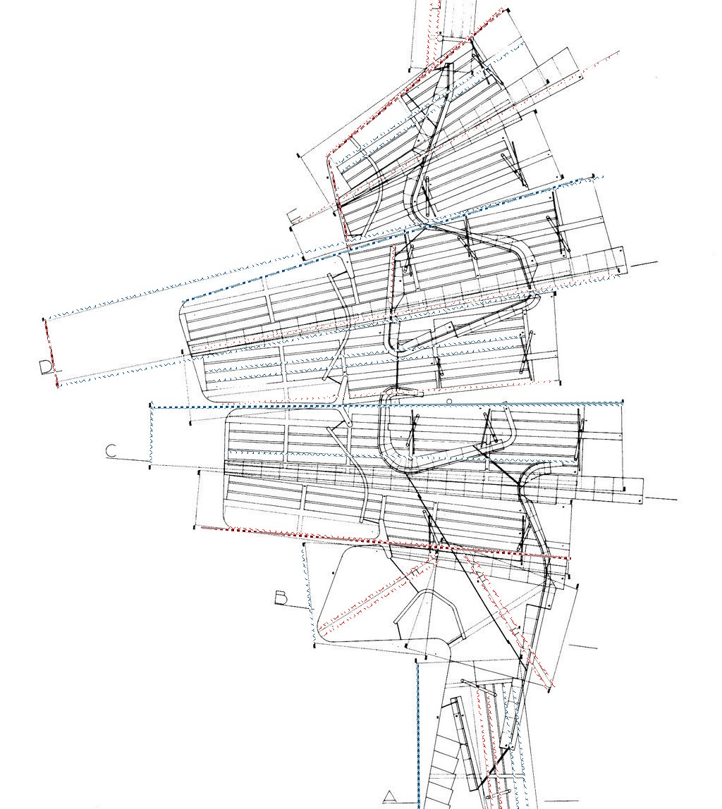

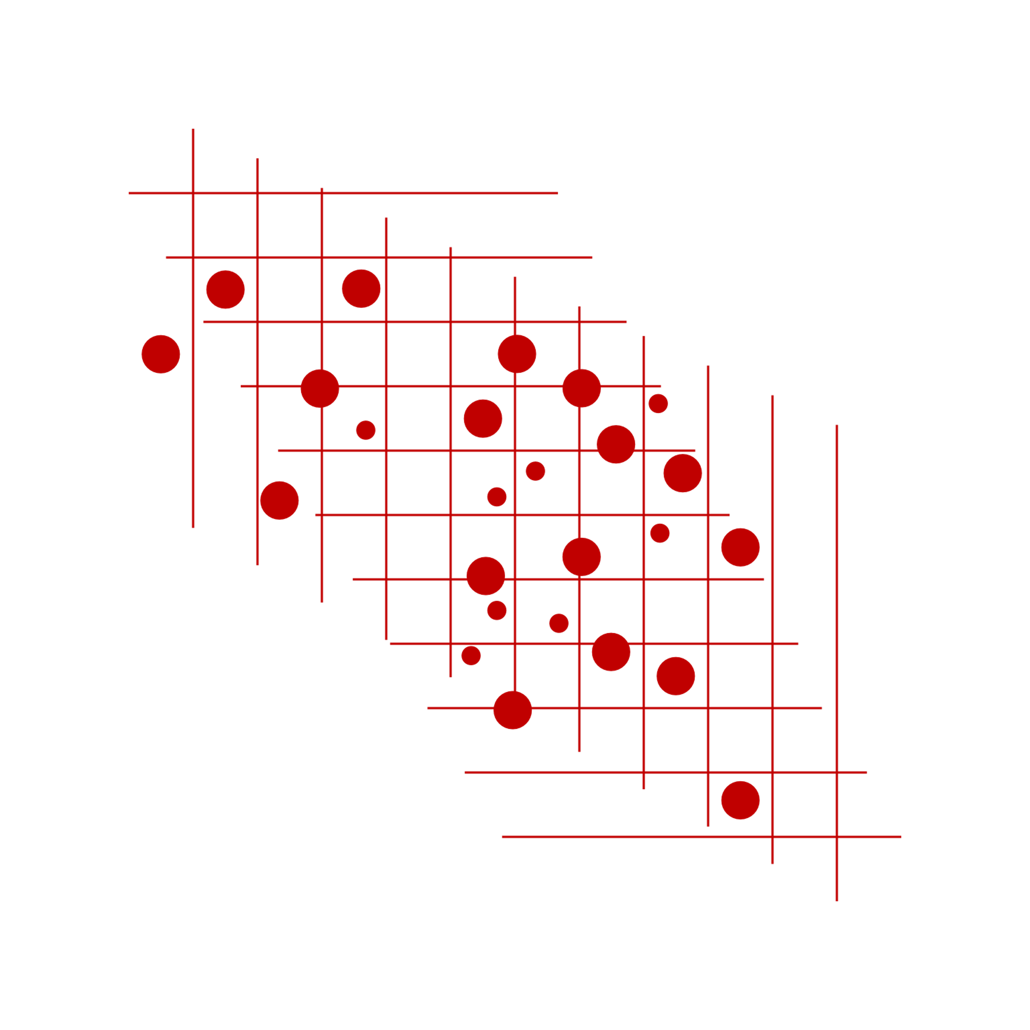



A Yada Yada Production
The Yada Yada Team presents...
A reverse engineering project meant for the programming architect: the database designer.

Slide 2
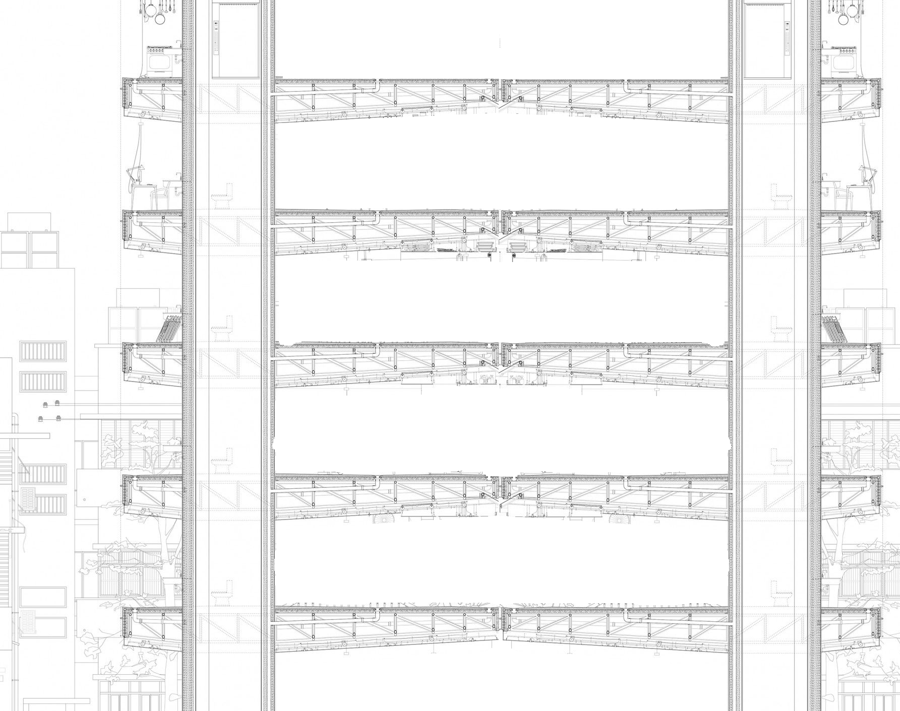
Introduction
Contents of this presentation
Flowchart
Our Entity Relationship Diagram (ERD)
Our Relational Schema (RS)
Extras and useful links
Our suggestions

Slide 3



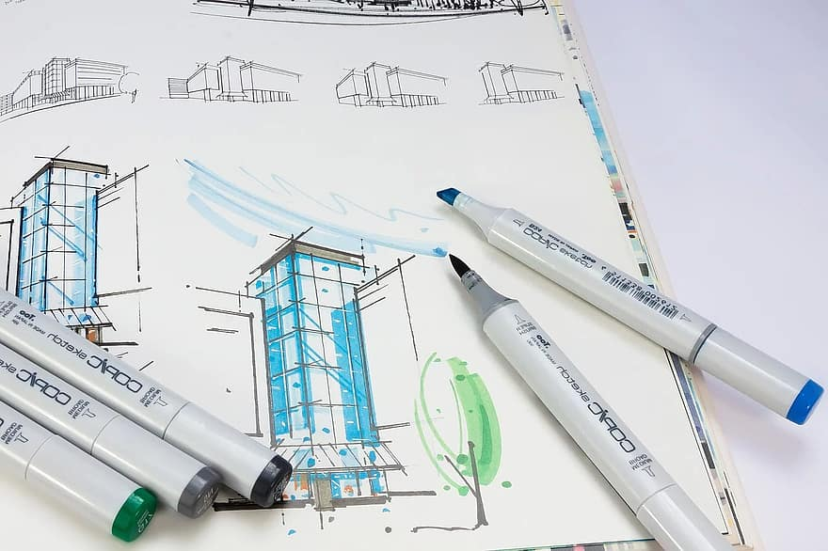
Introduction
In this presentation we aim to do an overall review of our work on the architectural structure of an Entity Relationship Diagram (ERD) and Relational Schema (RS) for the popular website IMDB. We were asked to reverse engineer parts of the website and create the database attributes on a conceptual level.
We will attempt to go through key points of our work with you, as well as discuss the main focus points of our project.

Slide 4




Our workflow chart
Analysis
Discerning entities and attributes
Defining relationships
Creating our Entity Relationship Diagram (ERD)
Converting our ERD into a Relational Schema
Bringing it all together

Slide 5
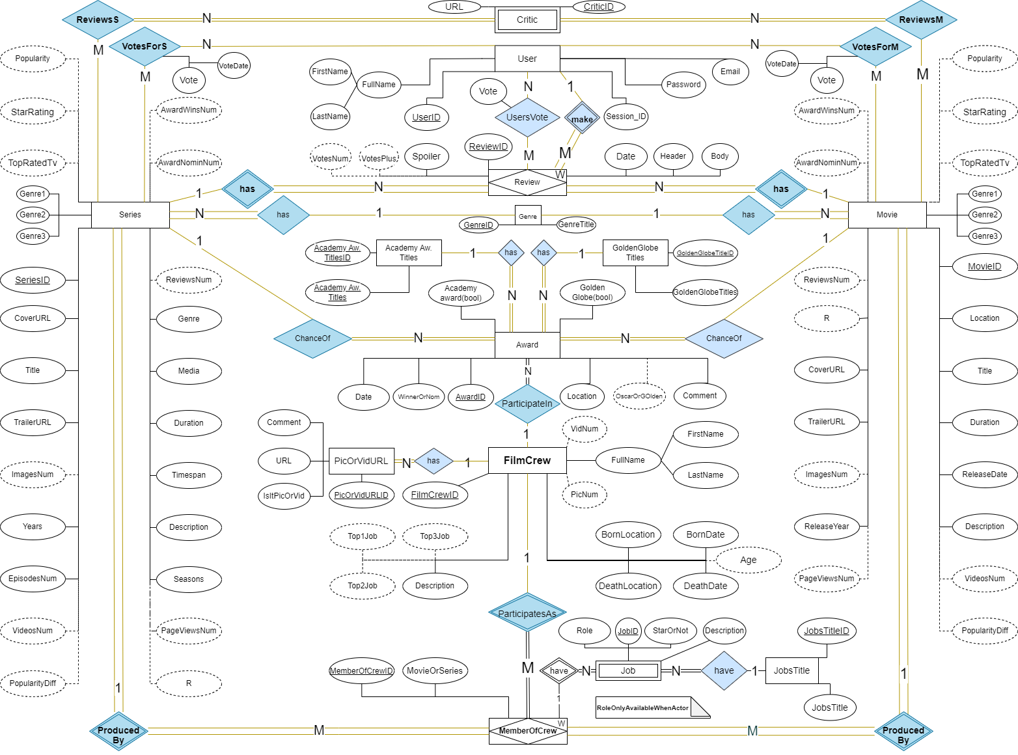

Slide 6

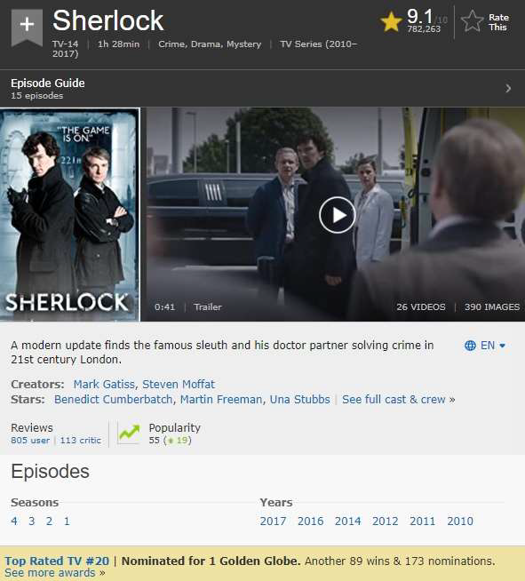

Slide 7
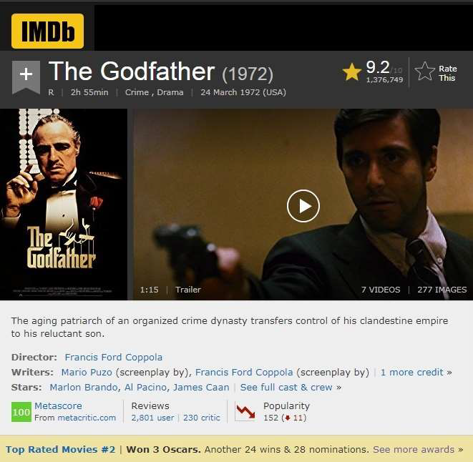

Slide 8
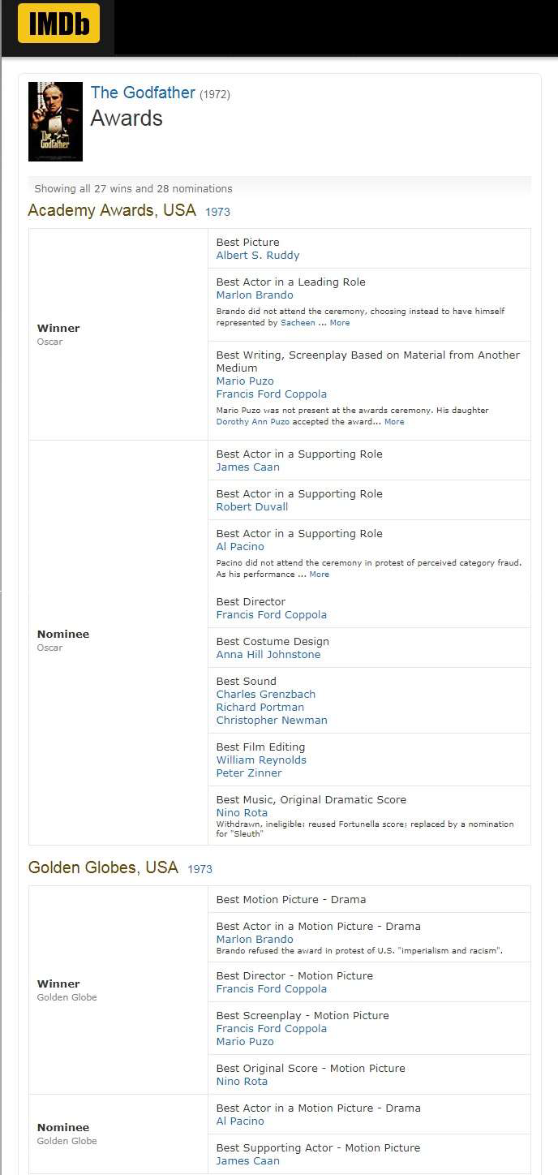

Slide 9
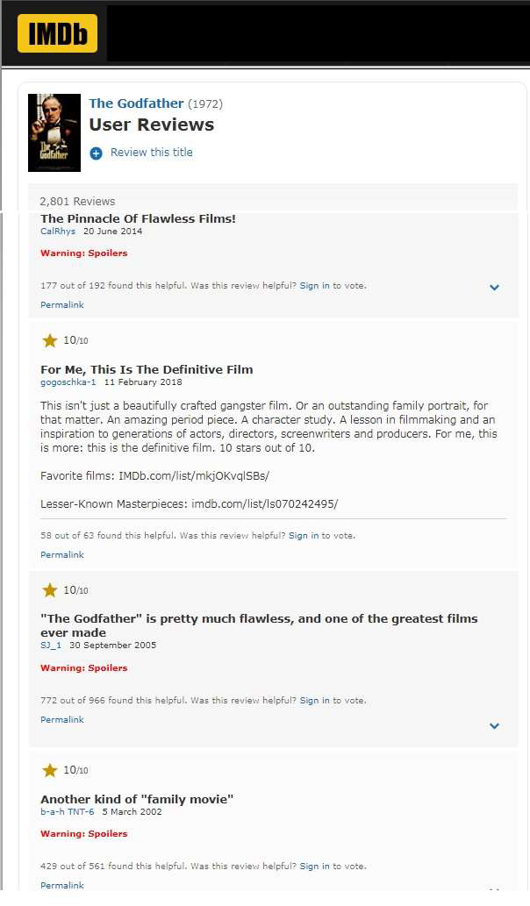

Slide 10


Slide 11
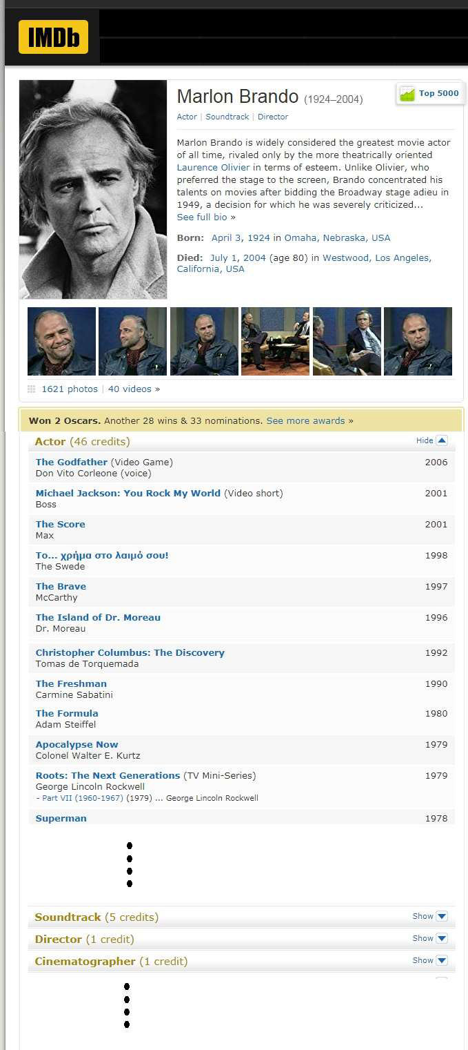

Slide 12
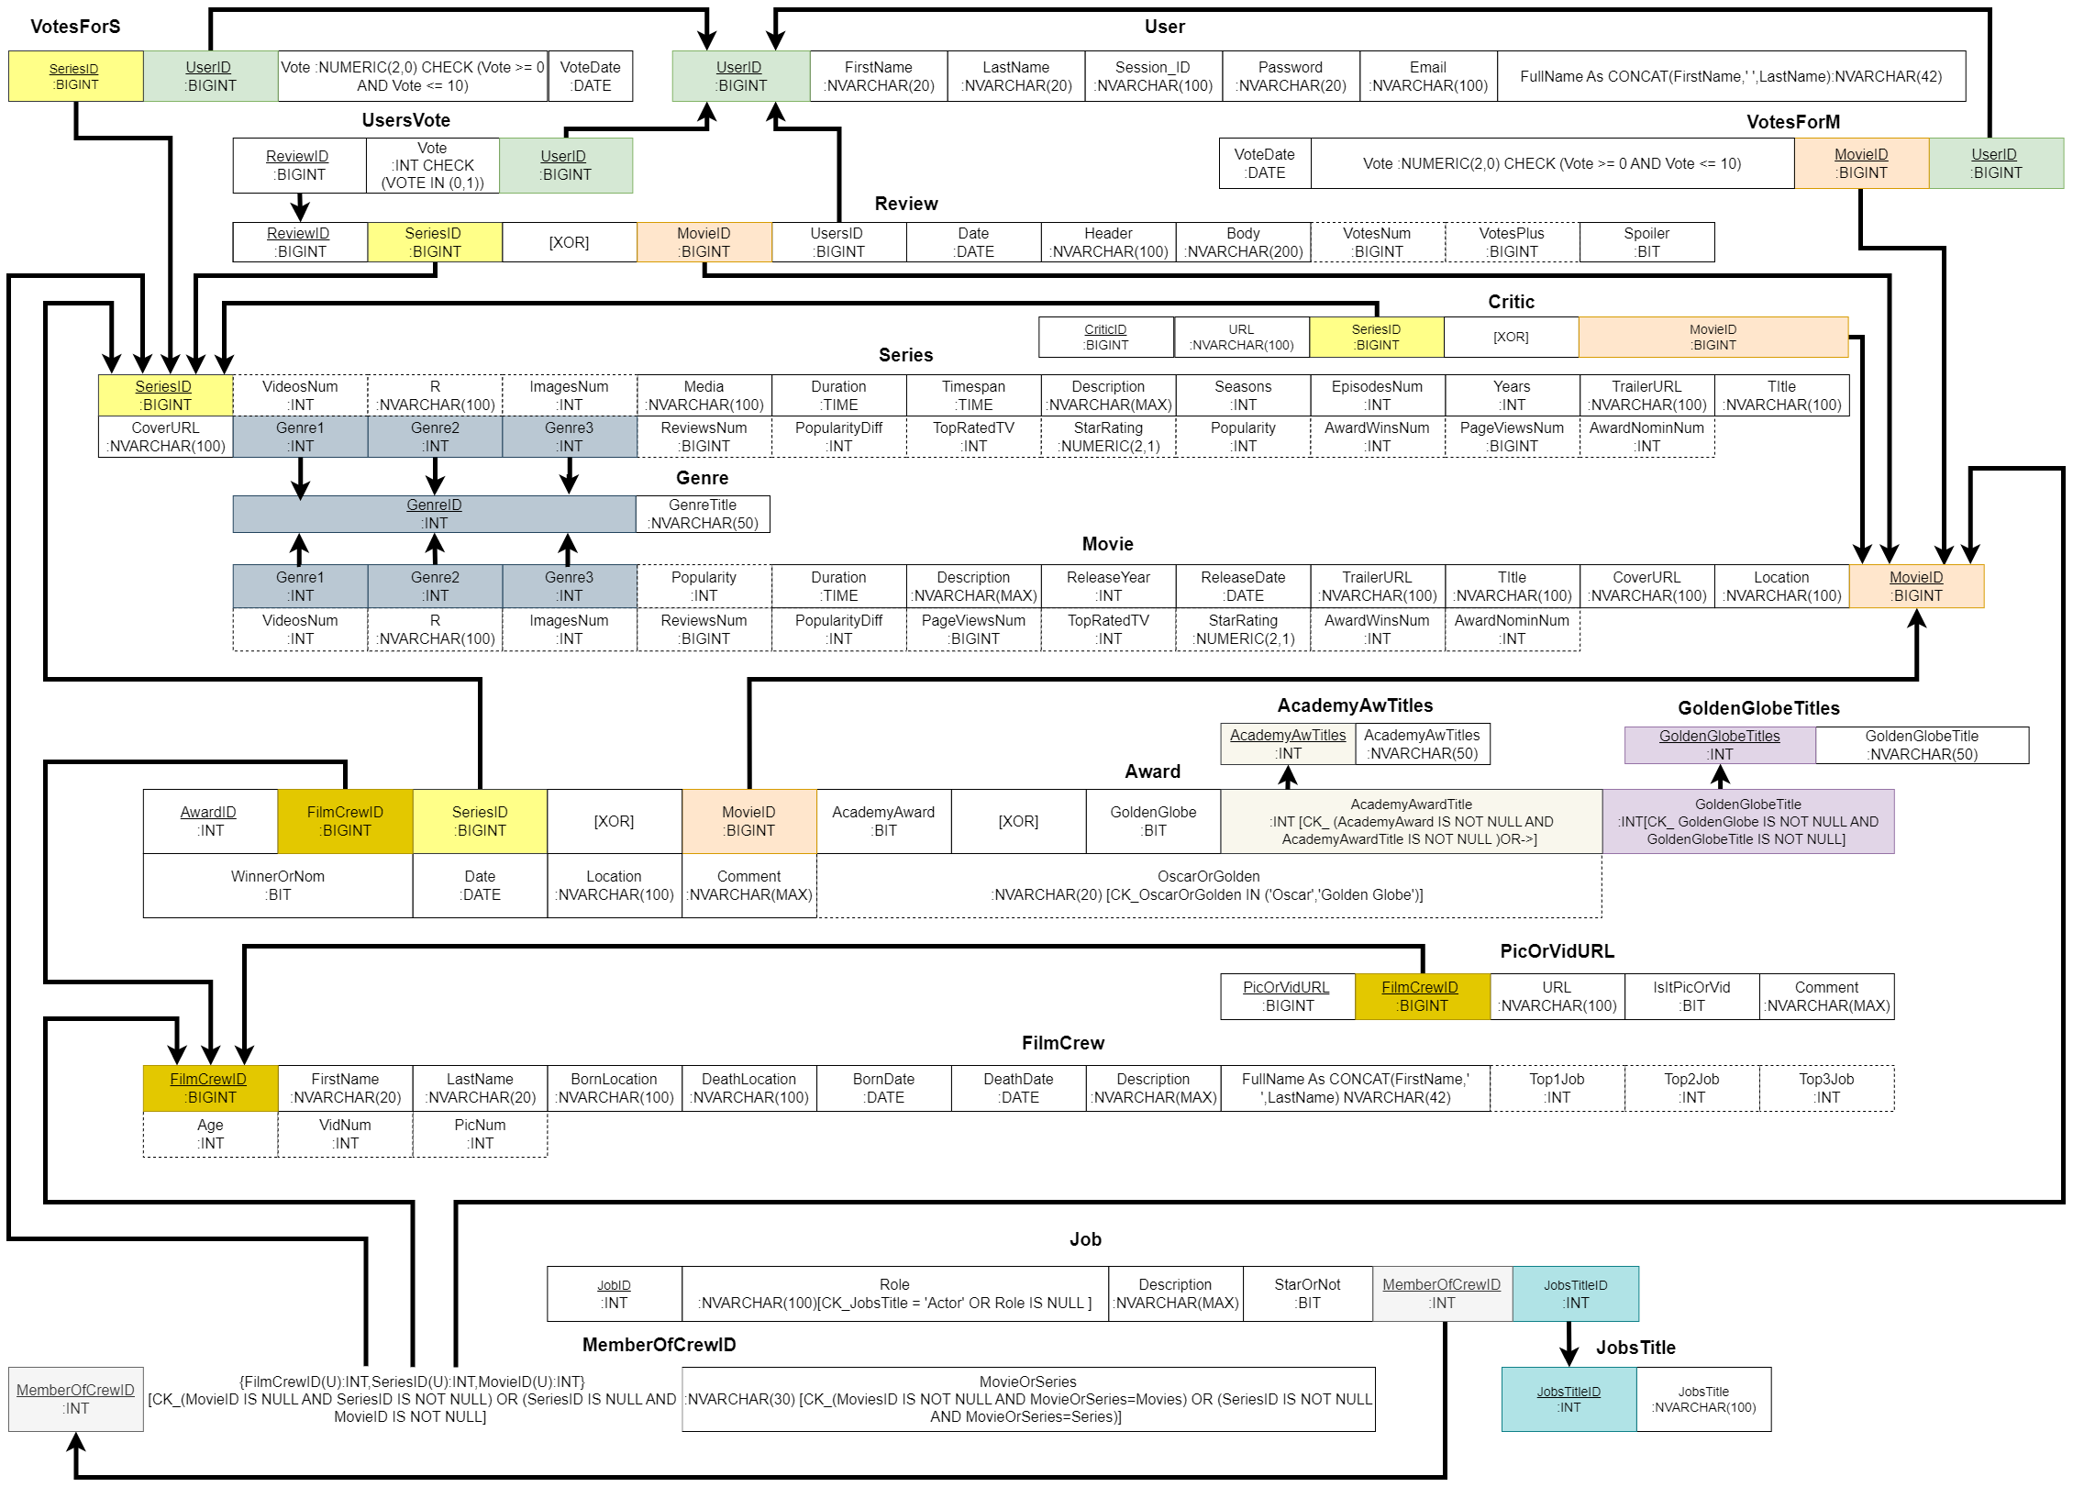
Our ERD was then transformed into a Relational Schema...
In order to make the design less complex, we have used certain indicators to display the constraints:
[XOR] indicates that only the entity on the right OR left of 'XOR' is allowed
Curly brackets group up a number of entities that are bound to the same constraint
[CK_] delineation of check constraint

Slide 14
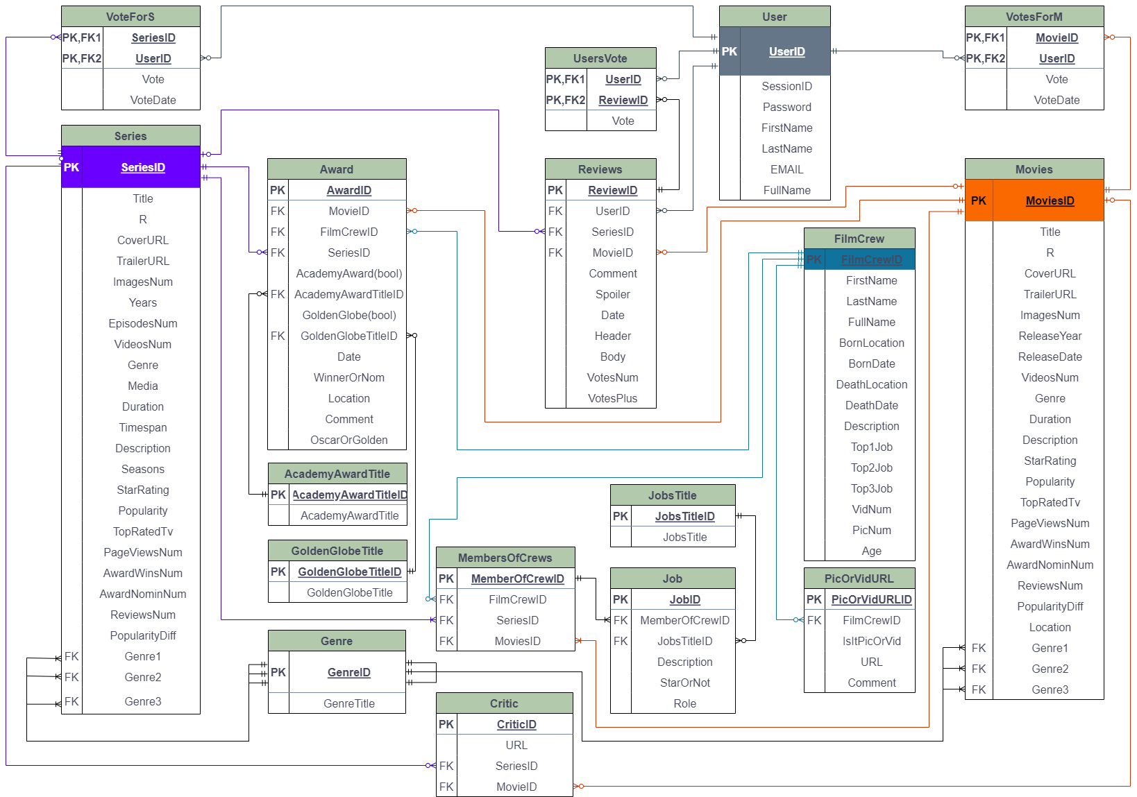

Slide 15


Our tools and useful links
Used Tools: Draw.io, Github and Git, MSSQL, Microsoft Teams
Versions and Links:
Designed with Draw.io 21.1.2
2. SQLversion: Microsoft SQL Server 2022 (RTM) - 16.0.1000.6
3. Github link: https://github.com/Balasis/Yada_Yada.git
Our SQL Project characteristics:
Constraints almost in every single attribute, so as to ensure input of the correct data values (email structure, URLs, dates diffs etc).
Optimization by indexing (nonclustered) columns of specific tables such as UsersVote (ReviewID) to increase performance.
Carefully attached triggers (no cursor/lock) to keep the tables up to date (e.x VideosNum etc) without affecting the performance.
Scheduled Daily Procedures/Jobs (Update Mov/Ser votes and ReviewNum) at 5-6 AM (low traffic hours).
All counts and any other statements are carefully made, in order to avoid needless repetitiveness and therefore boost performance.

Slide 16


We would like to leave you with a few suggestions moving forward...
Improve the popularity calculation so that it takes into account the age of the movie, the number of reviews/votes, as well as the page views.
Add a passive rating multiplier for people who are very active on the website – thus incentivizing people to further participate in the voting process.
Split the movie/series rating into further categories depending on each country's individual rating system.
Create a recommendations feature that provides the user with a list of movies/shows they might be interested in depending on their past activity on the website.

